Slide 1
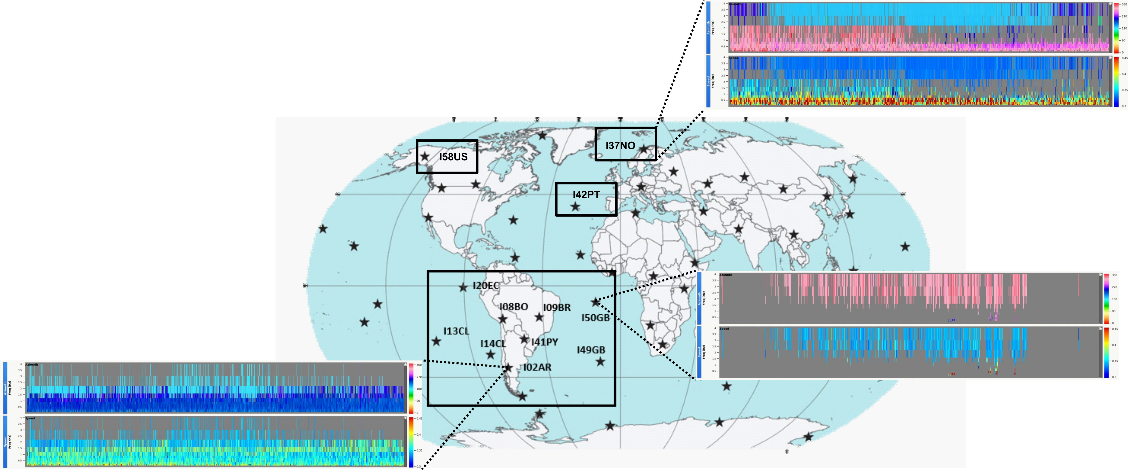
Correlation of Geomagnetic Storms with Infrasound Observation Data from International Monitoring System Stations Located in South America
Arthur S. de Macêdo, Elder Yokoyama, Lucas V. Barros, Darlan P. Fontenele and Juraci M. de Carvalho
University of Brasília
P1.1-489
I01AR
I02AR
Geomagnetic Storms and Infrasound Correlation in South America. Join us as we delve into the detections on IMS infrasound stations, observing the relationship between auroras occurrence and infrasound data.

